Slide 1
Shopping Website
Created By-
Ayush Patel, Amit Gupta,
Chirag K. S. and Kinjal Samrit

Slide 2
About
We have created a Shopping website for Buyers and Sellers to buy and sell products conveniently. There are various features for both buyers & sellers like viewing products, adding them to the cart, placing orders as well as checking out the previously ordered list for buyers and adding products with images for the buyers to view them for the sellers. They can also filter out and search according to their convenience.

Slide 3
Technologies Used:
> ASP.net MVC
> ASP.net Web Api
> Bootstrap 5
> jQuery

Slide 4
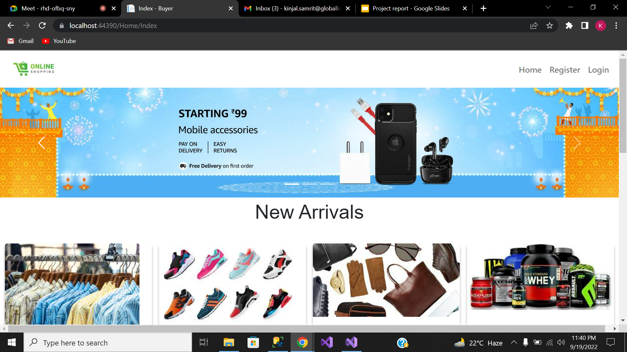
Homepage:

Slide 5
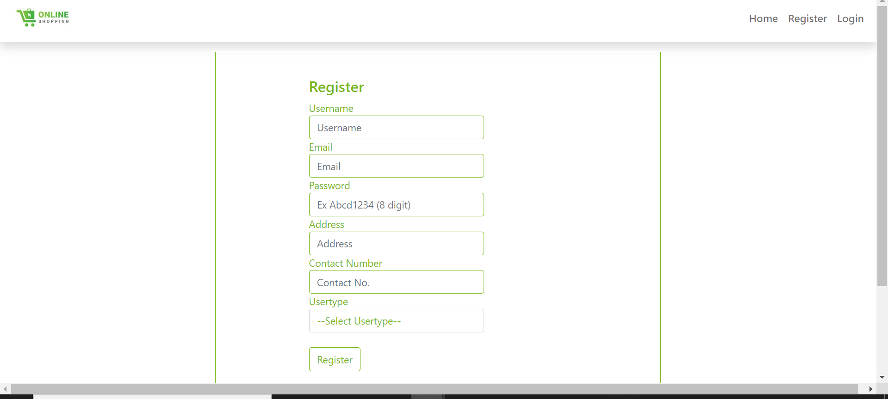
Register Page:

Slide 6
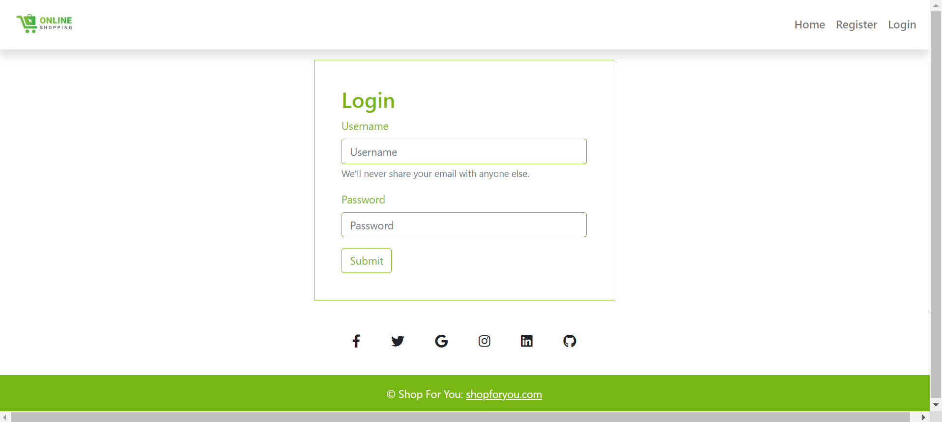
Login Page:

Slide 7
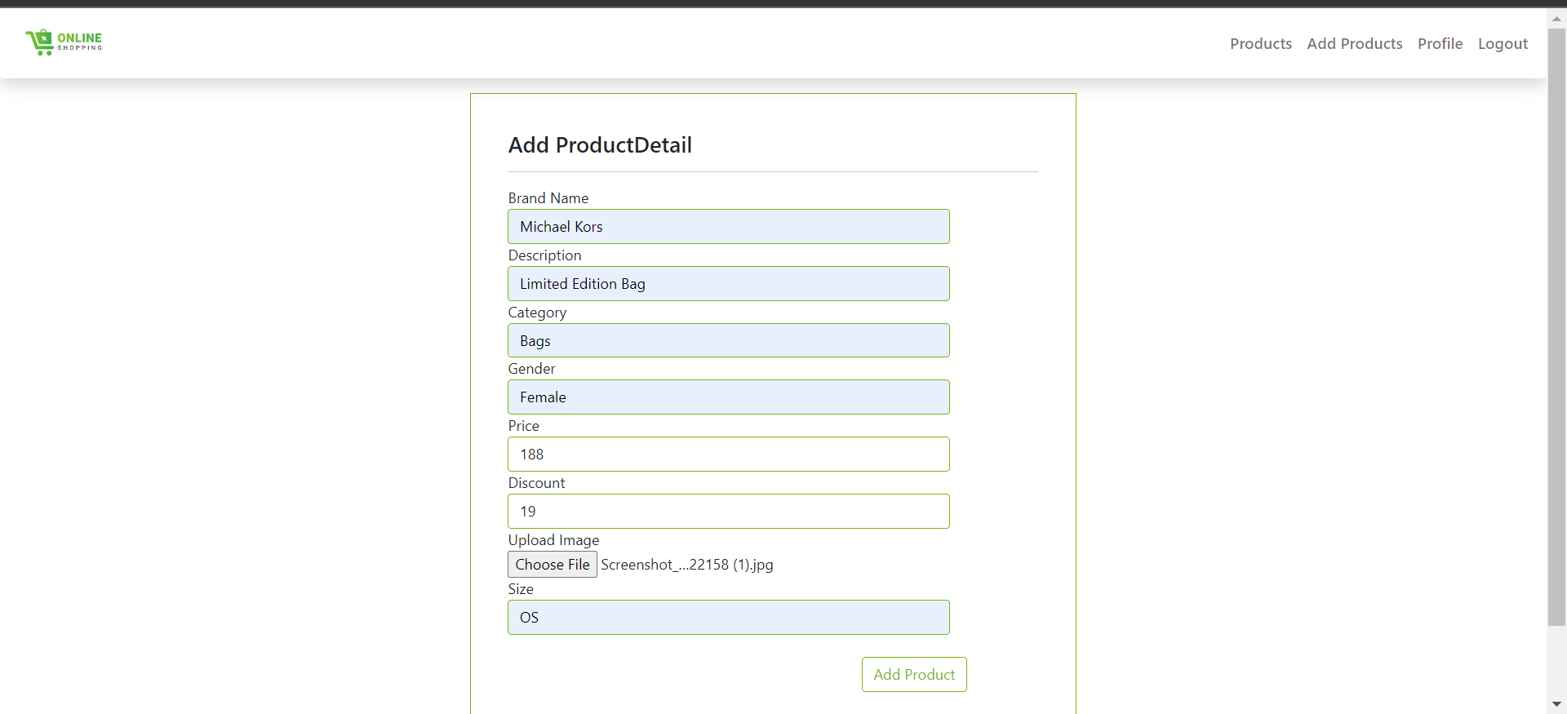
Seller page while Adding products:

Slide 8
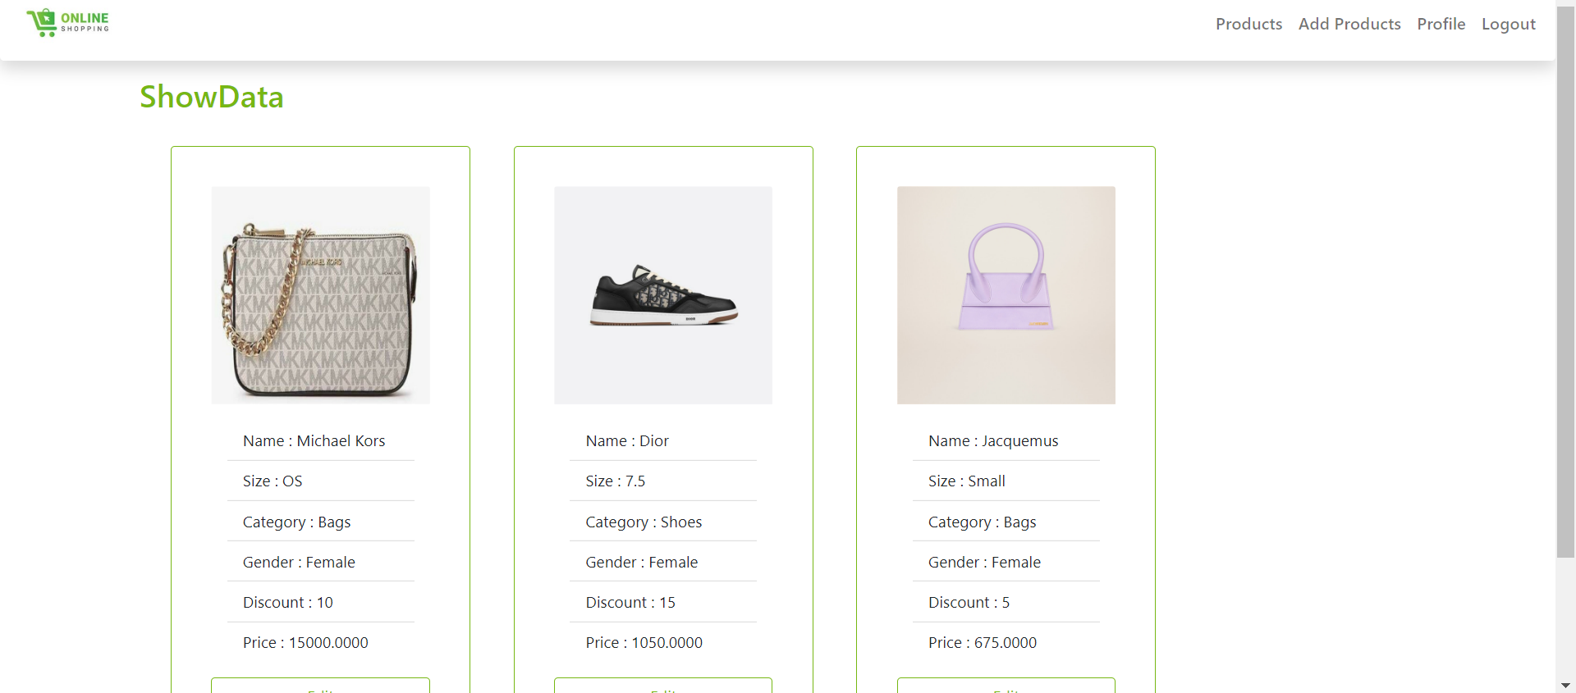
Seller Showdata page:

Slide 9
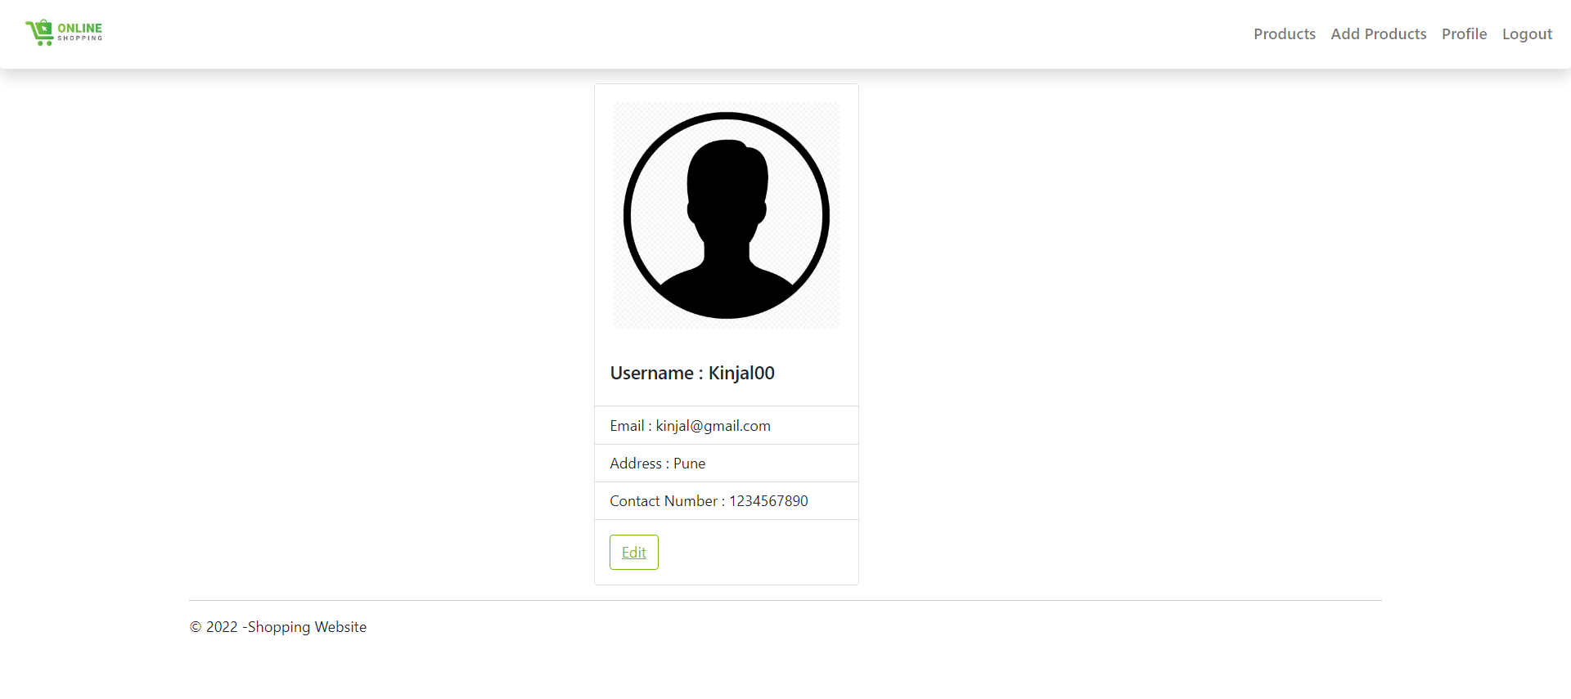
Seller Profile page:

Slide 10
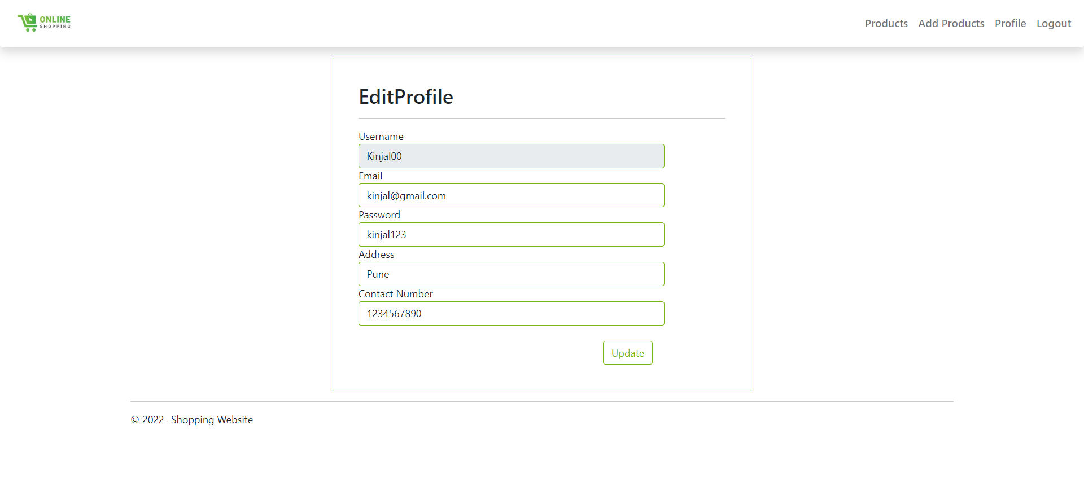
Seller Profile while editing page:

Slide 11
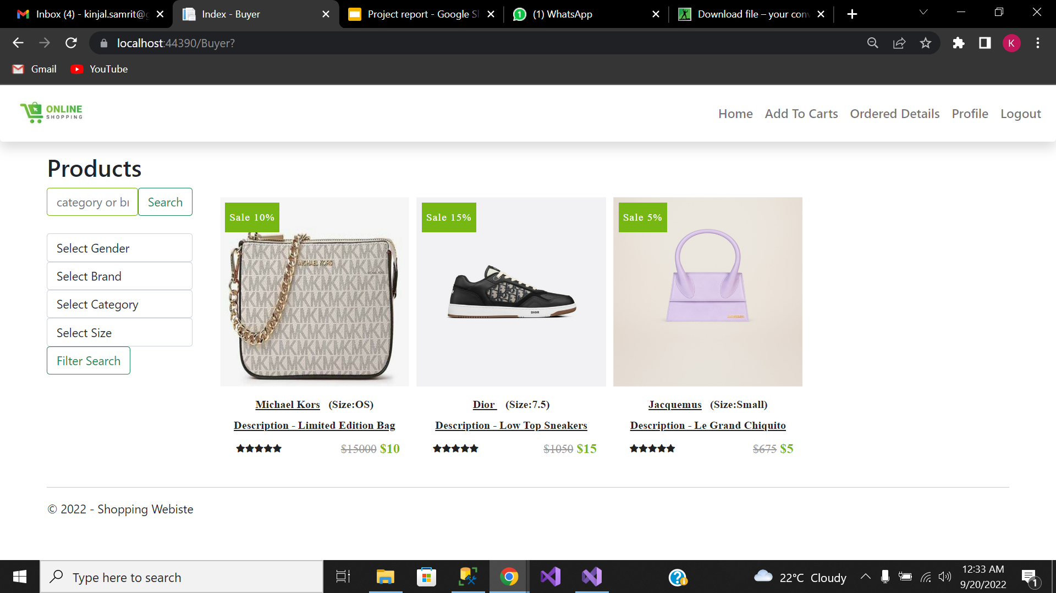
Buyer HomePage(with data):

Slide 12
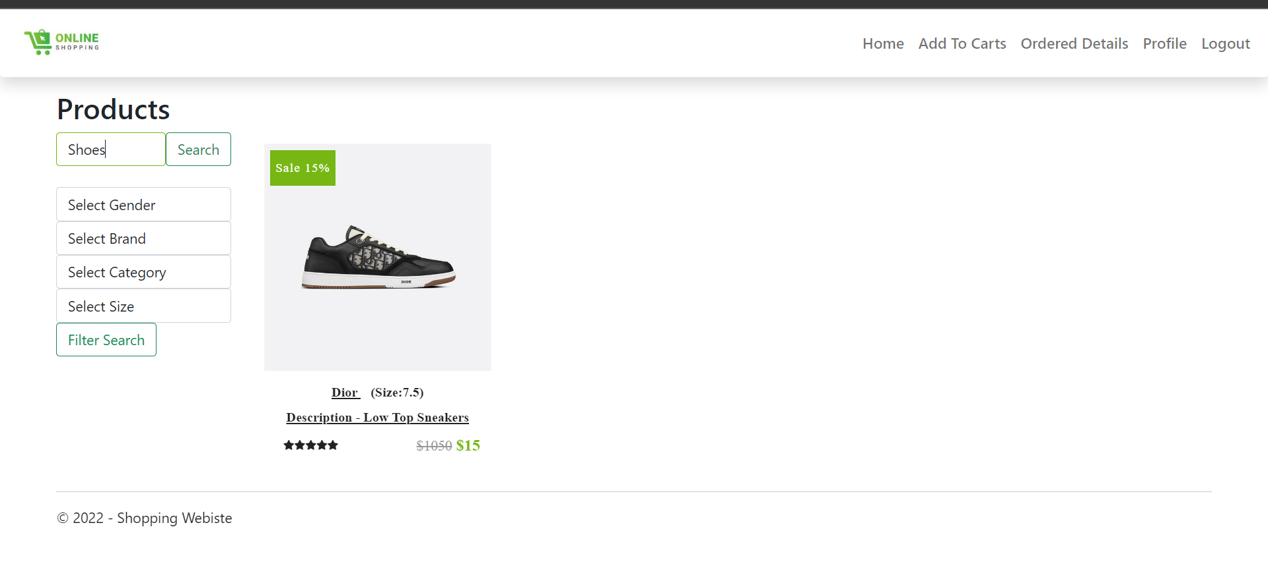
Buyer Data page using search:

Slide 13
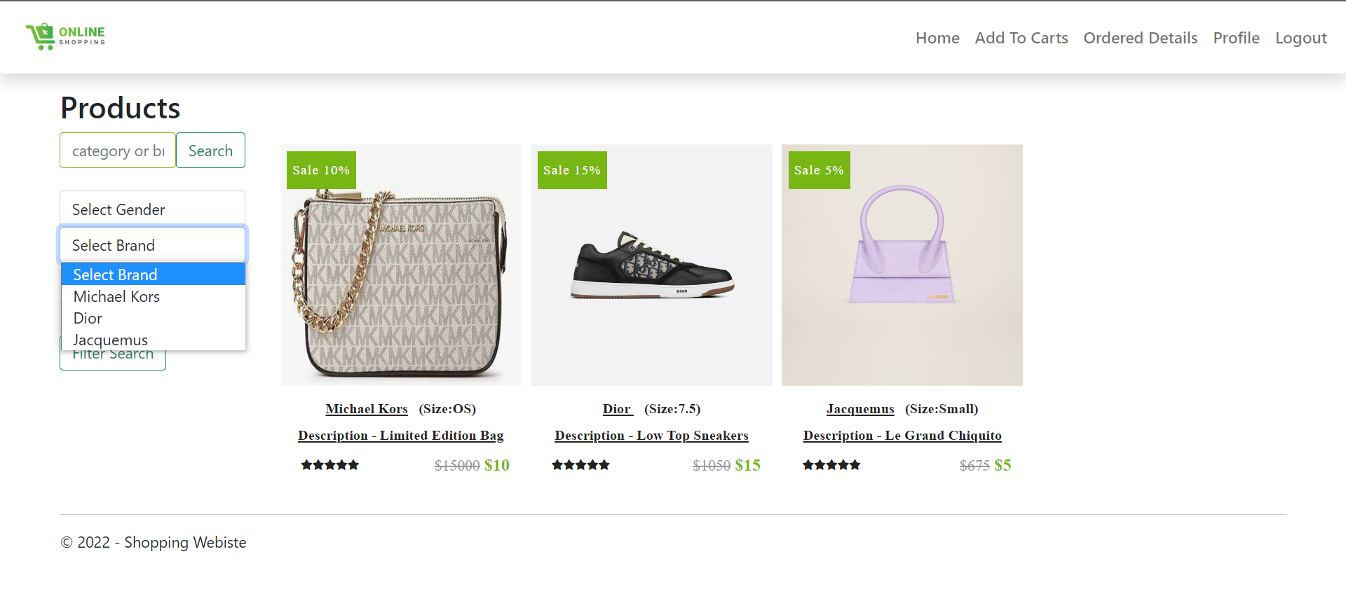
Buyer Product page by using Filter search:

Slide 14
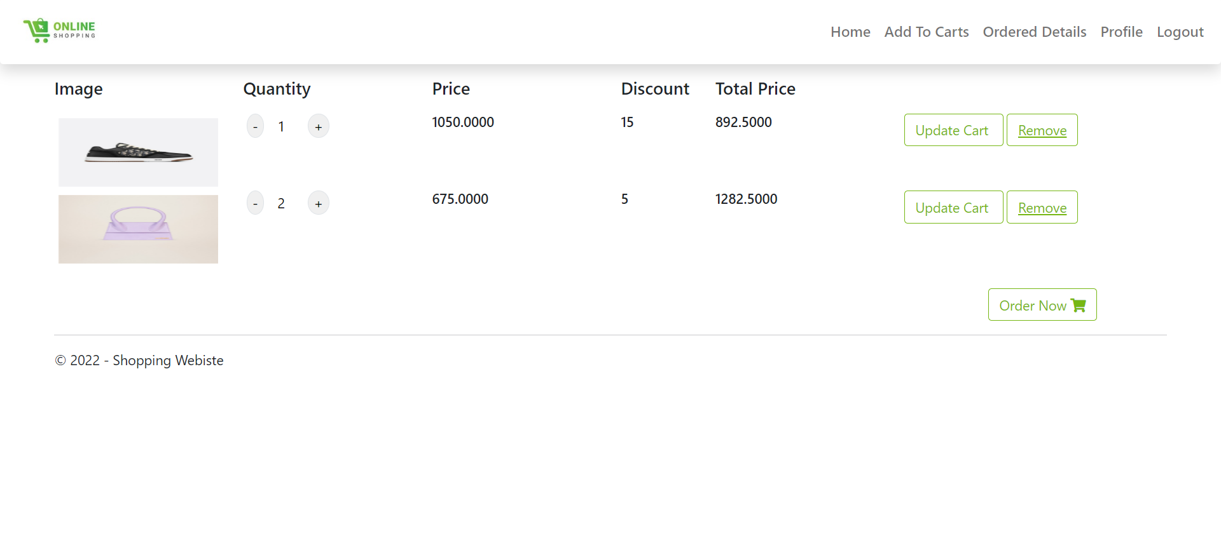
Buyer Add to Cart page:

Slide 15
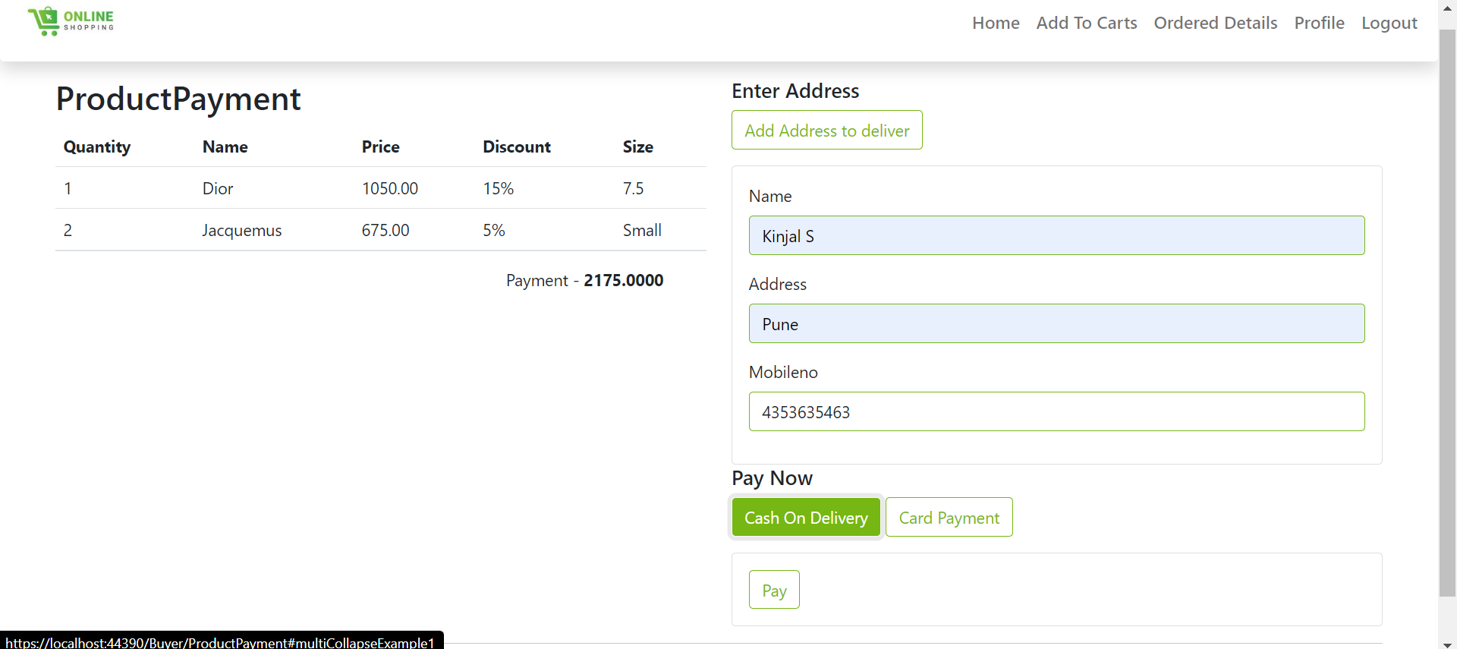
Buyer Payment Page:

Slide 16
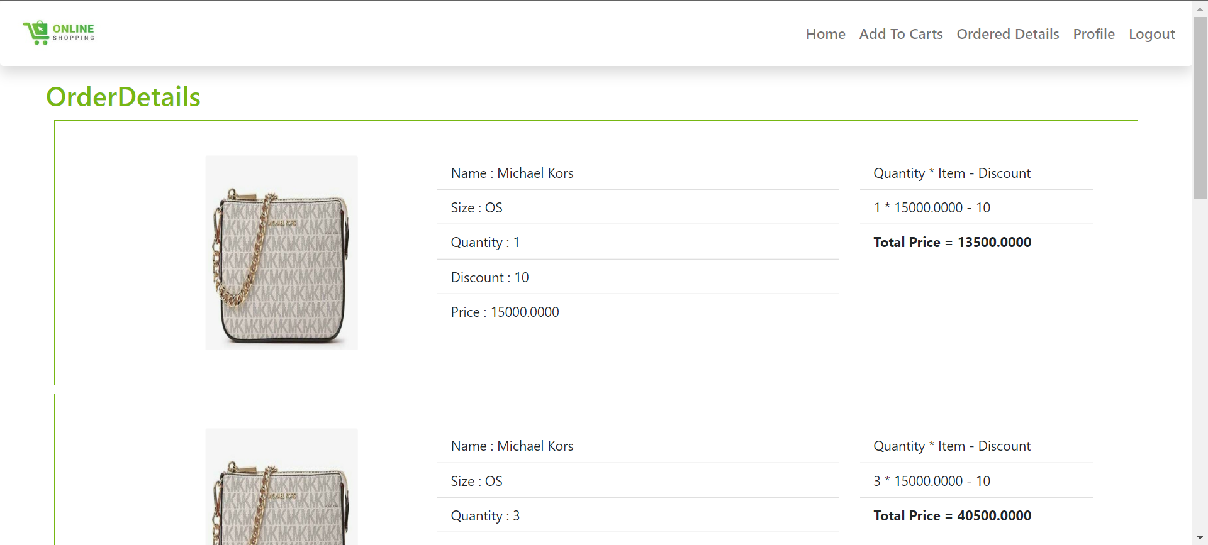
Buyer Order History page:

Slide 17
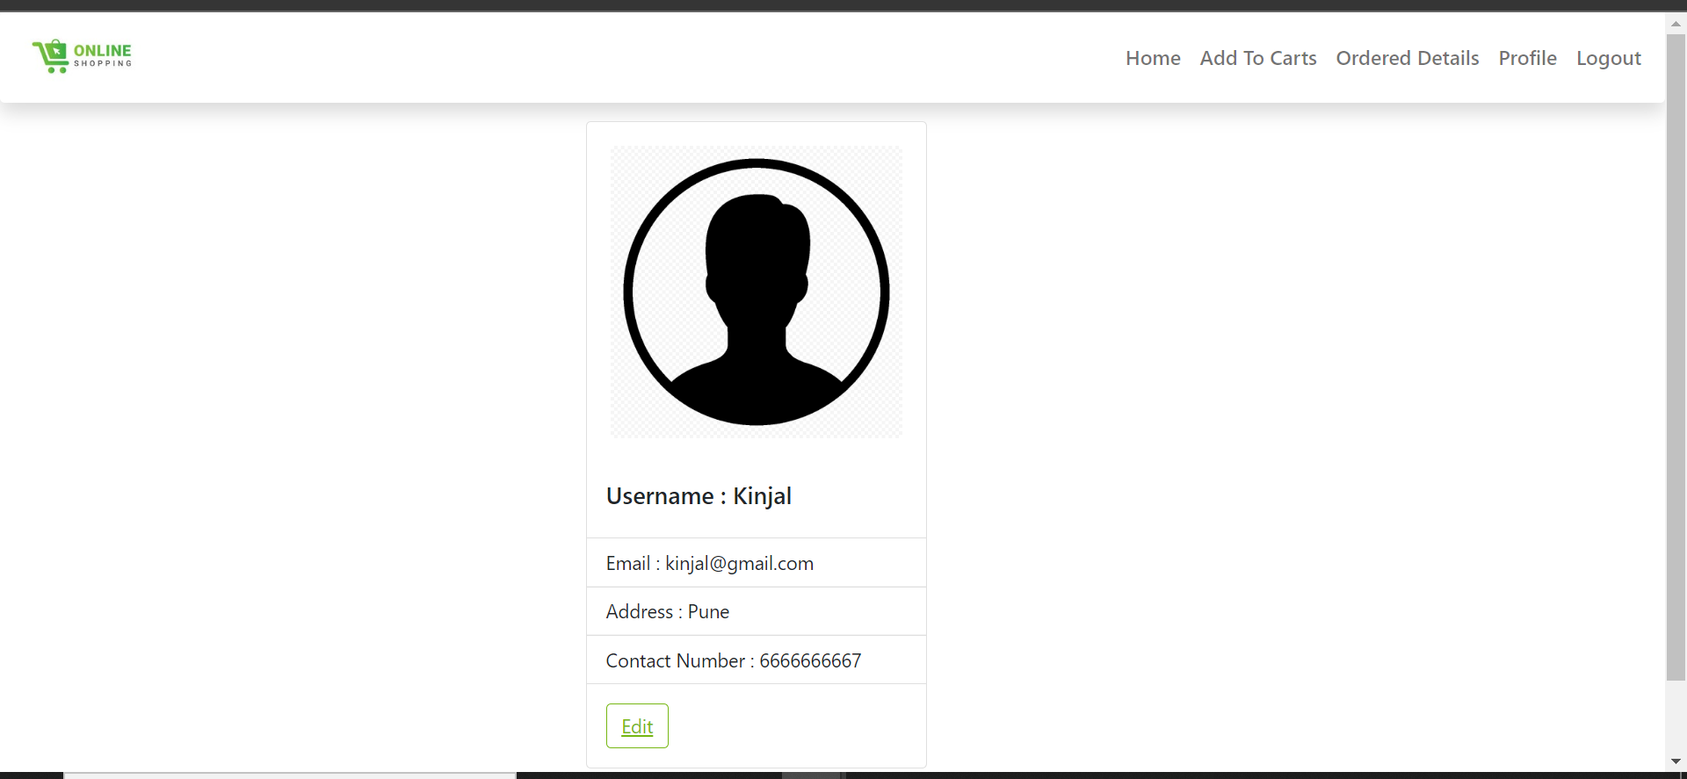
Buyer Profile page:

Slide 18
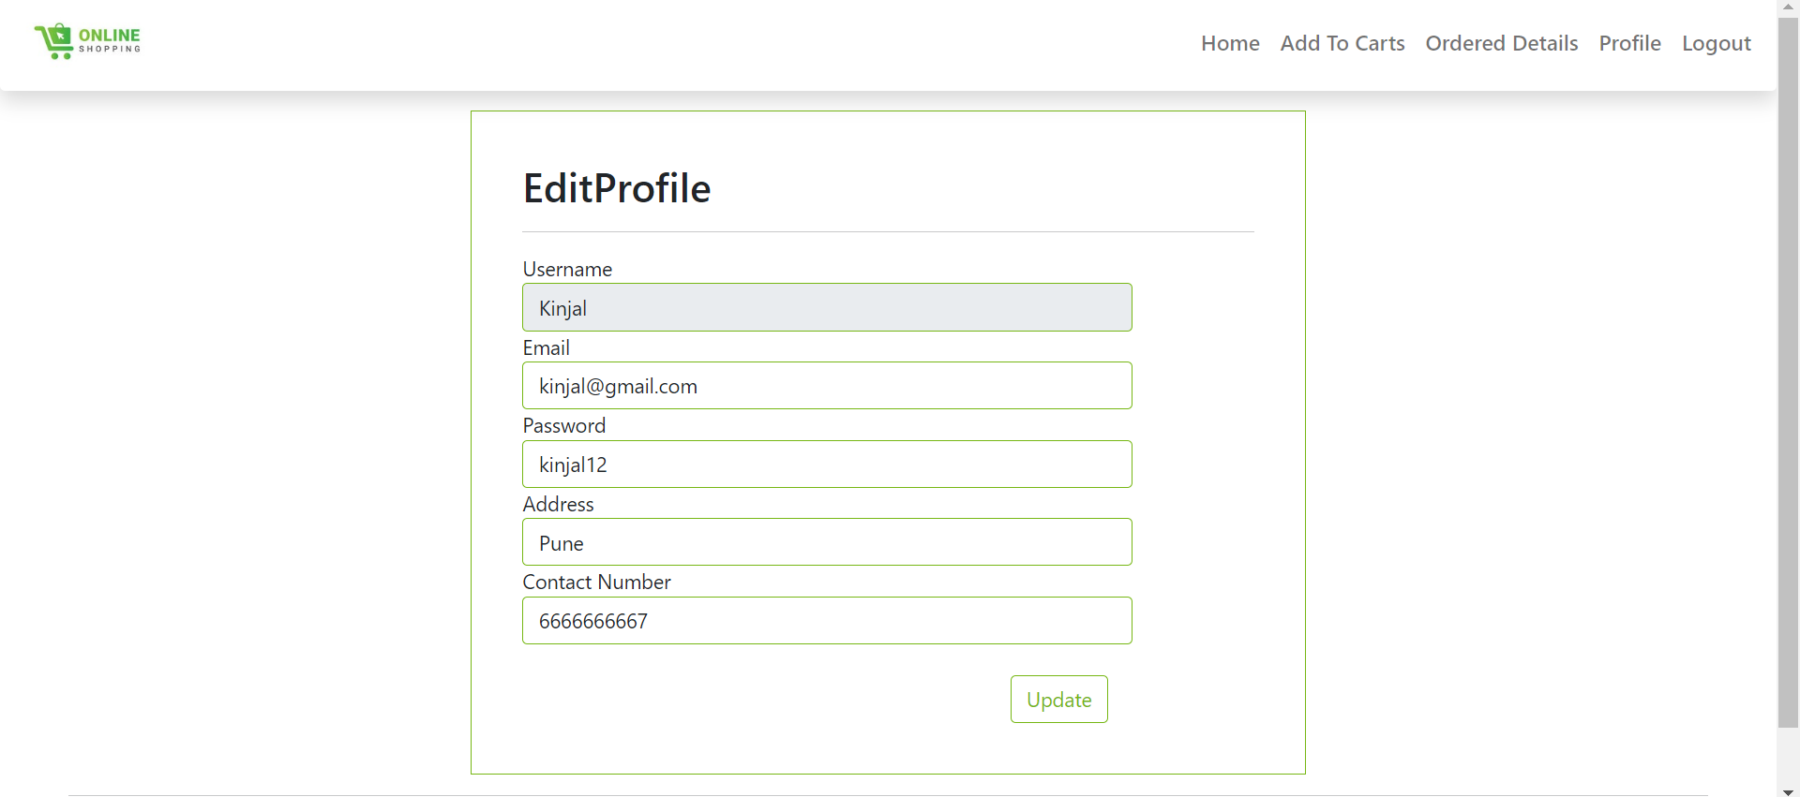
Buyer Profile while Editing:

